Slide 1

Robot Operating system
Lecturer: Dr. Bui Ha Duc
Dept. of Mechatronics
Email: ducbh@hcmute.edu.vn

Slide 2
Overview
Introduction to ROS
ROS architecture & philosophy
  Master, Nodes, Topic
  Command
  Workspace
ROS Services
  Subscriber and publisher
  Visualization

Slide 3

Introduction
ROS is an open source framework for robot control
ROS serve as a common software platform for people who are building and using robot
  Share code and ideas
  Contain >2000 software package → save time
Hardware Control
GUI tools
Computational Infrastructurre
Robotics algorithms
ROS
Simulation
Graphic user interface
Data logging
Process management
Inter-process communication
Device drivers
Control
Planning
Mapping
Perception
Package organization
Software distribution
Documentation
Tutorial
Notes:
1. A set of drivers that let you read data from sensors and send commands to motors and other actuators, in an abstracted, well-defined format. A wide variety of popular hardware is supported, including a growing number of commercially available robot systems.
2. A large and growing collection of fundamental robotics algorithms that allow you to build maps of the world, navigate around it, represent and interpret sensor data, plan motions, manipulate objects, and do a lot of other stuff. ROS has become very popular in the robotics research community, and a lot of cutting-edge algorithms are
now available in ROS.
3. All of the computational infrastructure that allows you to move data around, to connect the various components of a complex robot system, and to incorporate your
own algorithms. ROS is inherently distributed and allows you to split the workload across multiple computers seamlessly.
4. A large set of tools that make it easy to visualize the state of the robot and the algorithms, debug faulty behaviors, and record sensor data. Debugging robot
software is notoriously difficult, and this rich set of tools is one of the things that make ROS as powerful as it is.

Slide 4
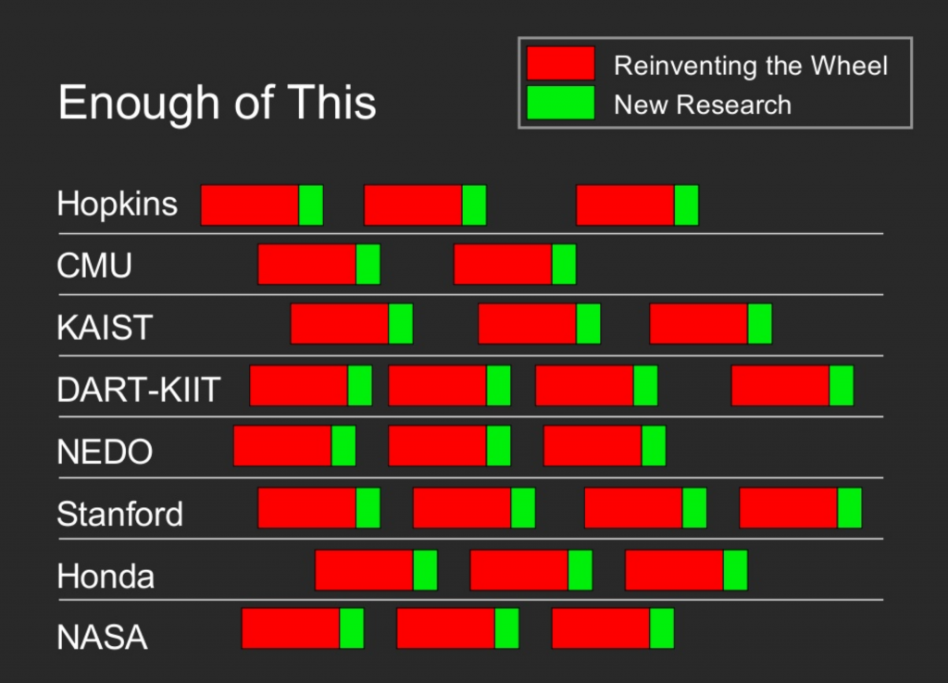
Introduction
Why ROS?
(Source: Keenan Wyrobek and Eric Berger slide)

Slide 5
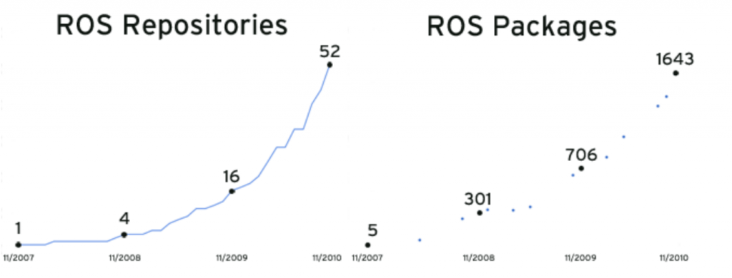
Introduction
History of ROS (https://www.theconstructsim.com/history-ros/)
Initiate by Standford University in May-2007
In Nov-2007, Willow Garage take the lead
After the close of Willow Garage in 2014, ROS becomes an open source framework
https_www.businessinsider.com/?url=https%3A%2F%2Fwww.businessinsider.com%2Fa-look-back-at-willow-garage-2016-2

Slide 6
Introduction
Website:
http://wiki.ros.org/
ROS tutorial:
  General tutorials: http://wiki.ros.org/ROS/Tutorials
  Tutorials for python: http://wiki.ros.org/rospy/Tutorials
  Free course: https://bit.ly/39ahoNN
  https://bit.ly/3fsiNjJ
Ebooks:
  Programming Robots with ROS, 1st Edition. by Morgan Quigley, Brian Gerkey, William D. Smart

Slide 7
ROS philosophy
Peer-to-Peer: individual packages communicate over defined API
Network: Multiple computer can run and communicate over the network
Multi-Language: ROS module can be written and multiple languages (C++, Python, Matlab, Java…)
Thin: stand-alone libraries are build inside ROS layer
Free and open source

Slide 8
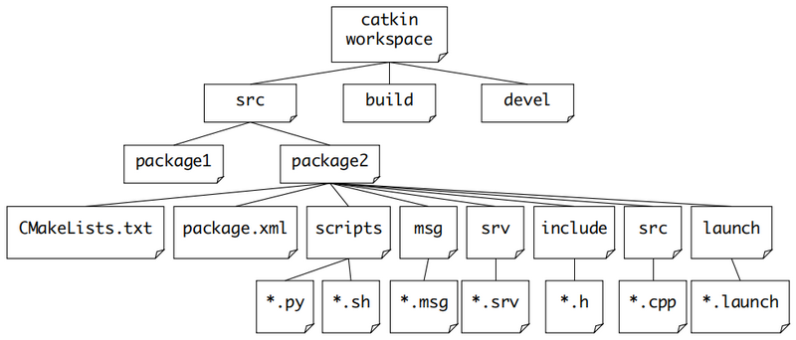
ROS Build System
ROS build system – catkin – is responsible for generating executables, libraries and interface from raw independent source code – packages
catkin also provides the concept of workspaces, where you can build multiple, interdependent packages together all at once.
http://wiki.ros.org/catkin/workspaces
Notes:
ROS is a very large collection of loosely federated packages. That means lots of independent packages which depend on each other, utilize various programming languages, tools, and code organization conventions. Because of this, the build process for a target in some package may be completely different from the way another target is built. catkin specifically tries to improve development on large sets of related packages in a consistent and conventional way.
Multi-language support

Slide 9
ROS Workspace
src
The source space contains source code for packages
build
Where CMake used to build the packages contained in src folder
devel
Developmental space where built targets are placed before being installed
Work here
Don’t touch

Slide 10
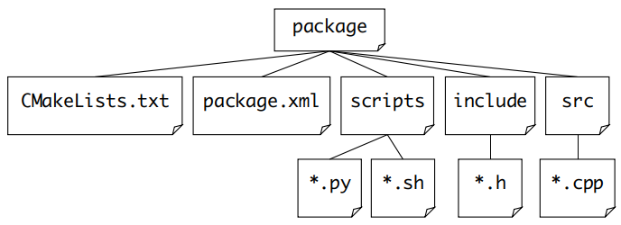
ROS Package
Package is the basic cell of ROS
Source Code
Set rules for catkin compilation
Defines the properties of package: name, version, authors…
More detail
http://wiki.ros.org/catkin/CMakeLists.txt
http://wiki.ros.org/catkin/package.xml
Notes:
When we execute the catkin_make instruction, the compilation system will look for the package executable package one by one.

Slide 11
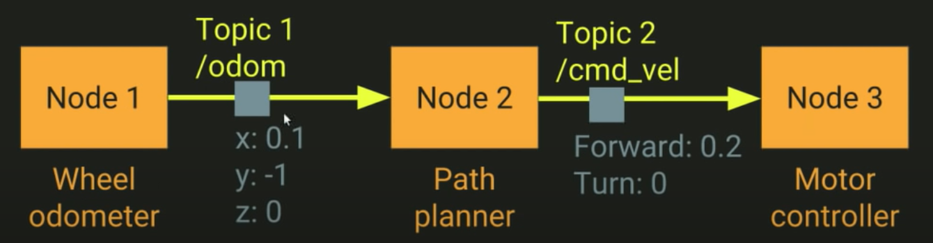
How ROS works
ROS ideas: a robotic task can be decomposed into many independent subsystems → Nodes
Nodes (code or tools) communicate with each other using messages → Topics
Each node can send or get data using publish/subscribe model
(Source: https://www.youtube.com/watch?v=bJB9tv4ThV4)

Slide 12
How ROS works
Publish/subscribe model
Any node can publish a message to any topic
Any node can subscribe to any topic
Multiple nodes can publish to the same topic
Multiple nodes can subscribe to the same topic
A node can publish to multiple topic
A node can subscribe to multiple topic
ROS message
A serialization format for structured data
Allows nodes written and C++ and python to communicate with each other

Slide 13
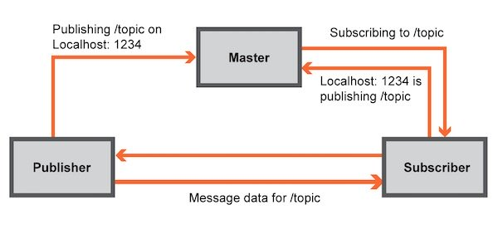
ROS Master
ROS Master is a server that provide connection information (addresses, notification) to nodes
The messages between nodes are transmitted peer-to-peer
Nodes must know network address of the master (ROS_MASTER_URI) before startup
ROS Master can be start with roscore
Local host: 1234 is publishing /topic
Subscribing to /topic
More detail: http://wiki.ros.org/Master
Notes:
Can work with multiple computers

Slide 14
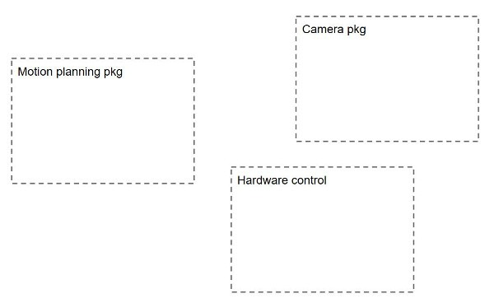
ROS Nodes
ROS Node is a single purpose, executable program
Each node is individually compiled, executed and managed
Node is organized in packages
ROS nodes for a mobile robot controlled by a camera
More detail
http://wiki.ros.org/Nodes
http://wiki.ros.org/rosnode

Slide 15
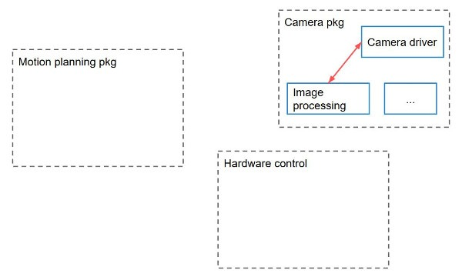
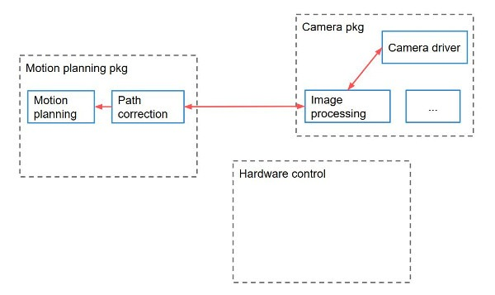
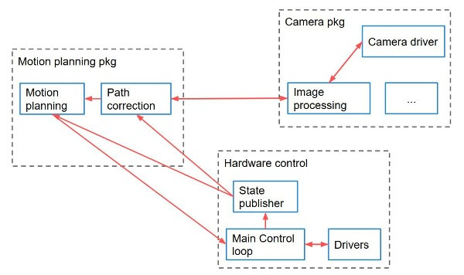
ROS Nodes
Notes:
combined into a graph
Reduce code complexity
Better fault tolerance
Language agnostic

Slide 16
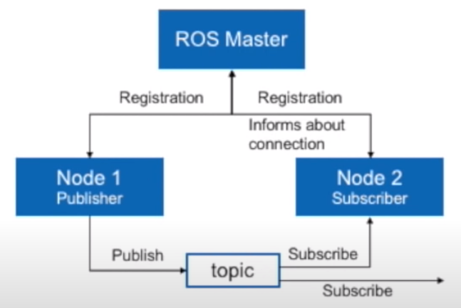
ROS Topics
Topic is a named bus for a stream of messages
Topics are intended for unidirectional
Nodes communicate over topics
All nodes publishing or subscribing to a topic must have the same data type which is given by the topic.
More detail
http://wiki.ros.org/Topics
http://wiki.ros.org/rostopic

Slide 17
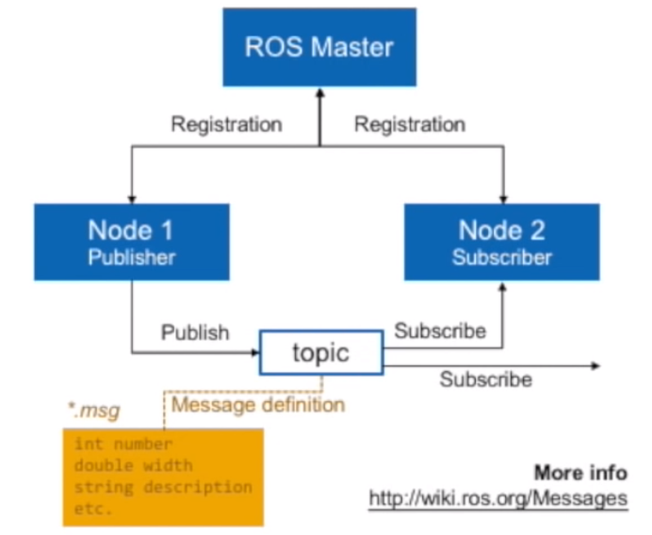
ROS Messages
Message is a data structure defining the type of a topic
Compromised of a nested structure of integers, floats, string…
Message is defined in *.msg files
More detail
http://wiki.ros.org/Messages
http://wiki.ros.org/rosmsg

Slide 18
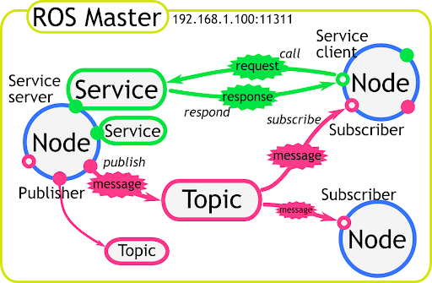
ROS Service
Service is a flexible communication paradigm that support request/ reply interaction
Service are intended for bidirectional
Service defined by a pair of messages
  one for the request
  one for the reply
More detail
http://wiki.ros.org/Sevices
http://wiki.ros.org/rossrv

Slide 19
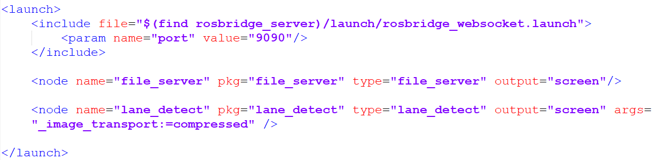
ROS Launch
Launch file is a XML document, which specifies:
  Which nodes to execute
  Their parameters
  What other launch file to include
Launch file has .launch extension
More detail
http://wiki.ros.org/roslaunch

Slide 20
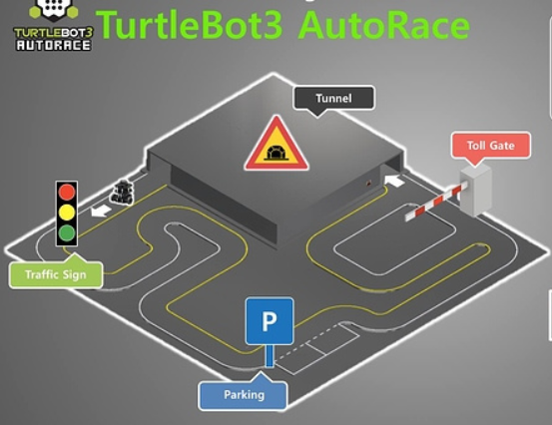
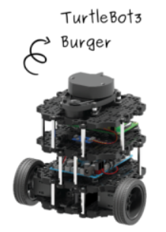
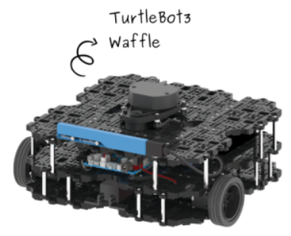
ROS Example
https://emanual.robotis.com/docs/en/platform/turtlebot3/autonomous_driving/
https://www.youtube.com/watch?v=74NnDkFFGV8

Slide 21
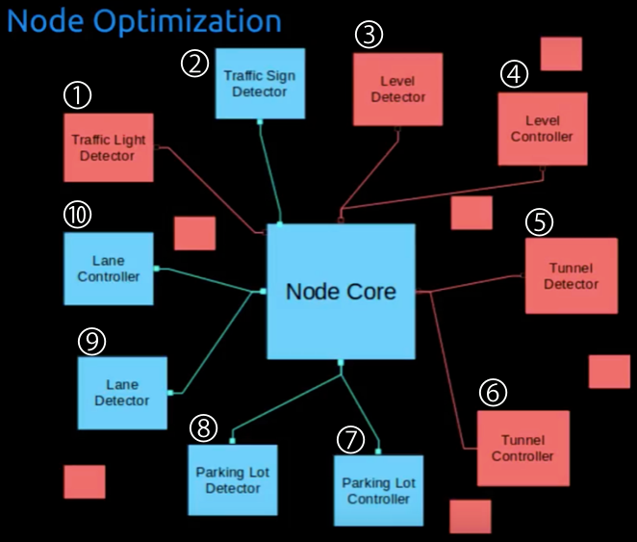
Nodes

Slide 22
Define the Robot

Slide 23
URDF - Unified Robot Description Format
Unified Robot Description Format (URDF) is an XML format used to describe all the elements of a robot.
  Links and joints
  Kinematic, dynamic and visual properties
Benefits of URDF:
  Simple and standardized
  Keep all the physical characteristic in one common place
URDF is made up of a few simple structures repeated over and over.

Slide 24
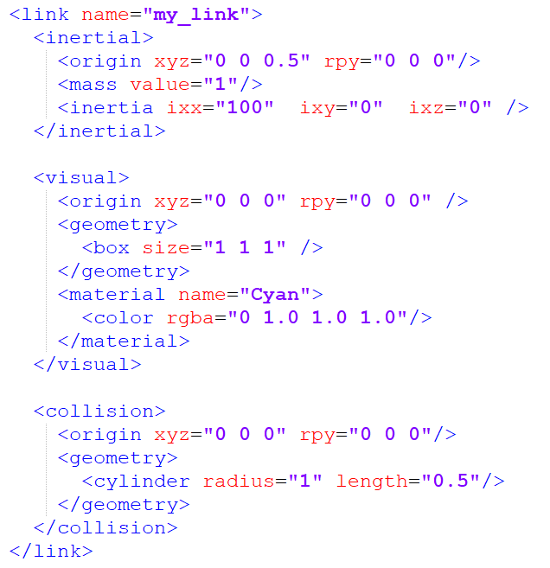
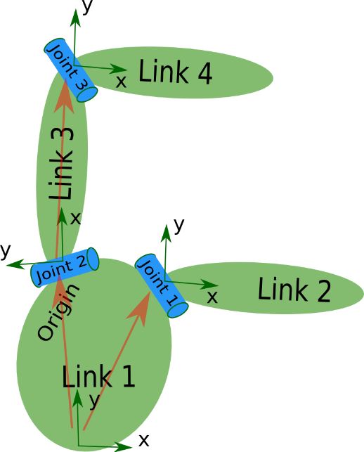
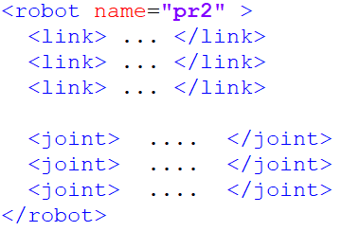
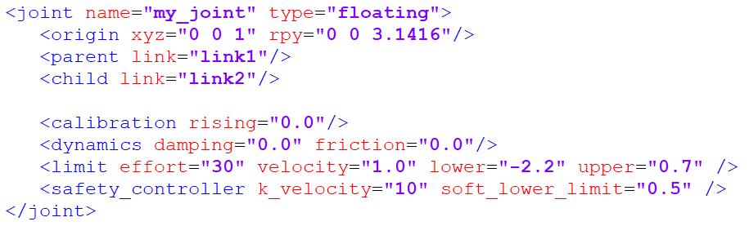
URDF Components
URDF consists of:
  Link elements: represent the physical components of the robot
  Joint elements: represent how one link moves relative to another link
pr2.urdf
More detail
http://wiki.ros.org/urdf/XML/model

Slide 25
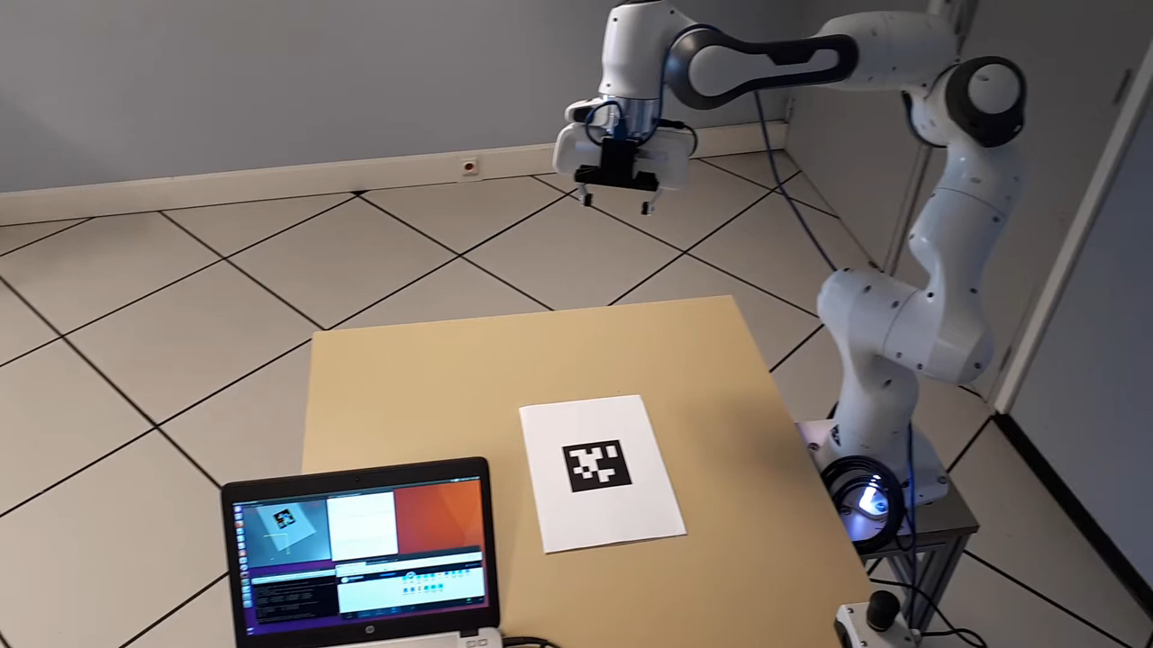
Links and Joints
Identify links and joints of this Robot arm

Slide 26
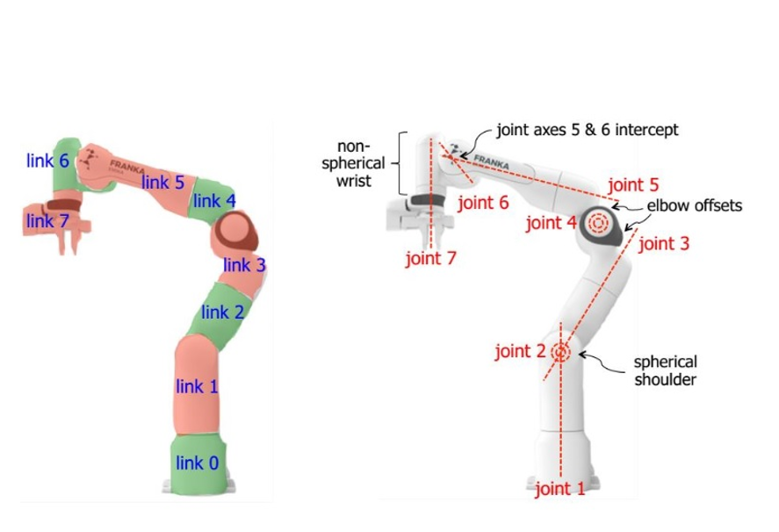
Links and Joints

Slide 27
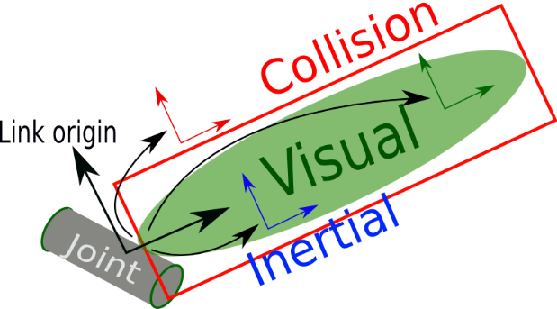
Links and Joints
Links
Visual - This is visual properties of the link.
  Geometry - box/ cylinder / sphere with size parameters, or a mesh
  Origin - an offset for the geometry so it doesn’t need to be centred around the link origin
  Material - Basically, the colour.
Inertial - used for physics calculations, but determines how the link responds to forces.
  Mass - Mass of the link
  Origin - The centre of mass (a.k.a centre of gravity).
  Inertia - The rotational inertia matrix.It describes how the distribution of the mass will affect rotation.
More detail
http://wiki.ros.org/urdf/XML/link

Slide 28
Links and Joints
Links
  Collision - used for physics collision calculations.
  Geometry and Origin - Same options as for visual. This will often be copy-pasted from the Visual tag.
More detail
http://wiki.ros.org/urdf/XML/link

Slide 29
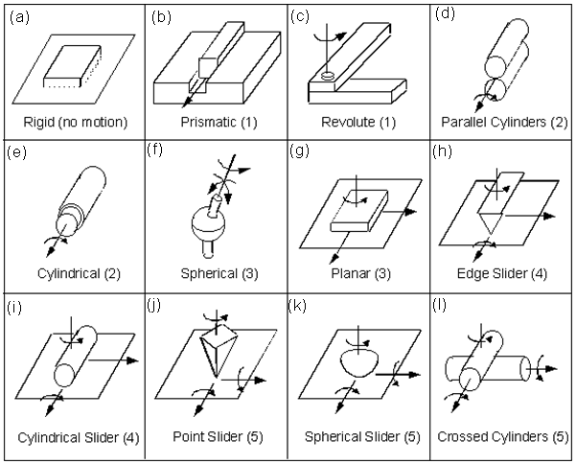
Links and Joints
Joints

Slide 30
Links and Joints
Joints: Each joint will need to have the following specified
  Name - A name for the joint.
  Type - joint type, the four most popular being fixed, prismatic, revolute, and continuous.
  Parent and child links - Which links this joint defines a relationship between
  Origin - The relationship between the two links, before any motion is applied
  Axis - Which axis to move along or around
  Limits - Physical actuation limits, which may be expected by other parts of the system. These can include:
  Upper and Lower position limits - in metres/radians
  Velocity limits - in m/s or rad/s
  Effort limits - in N or Nm

Slide 31
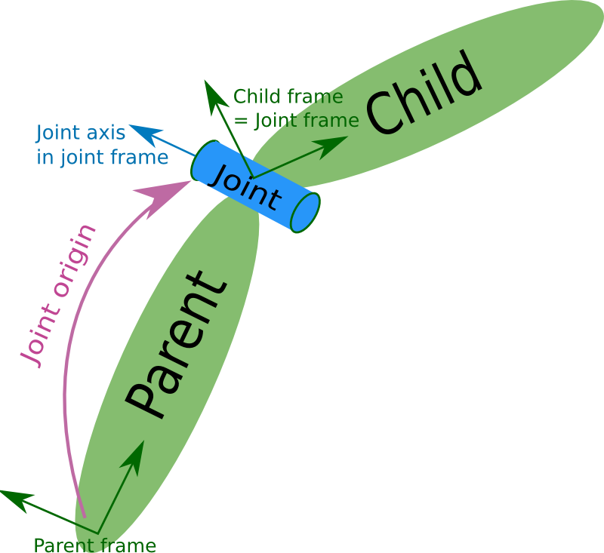
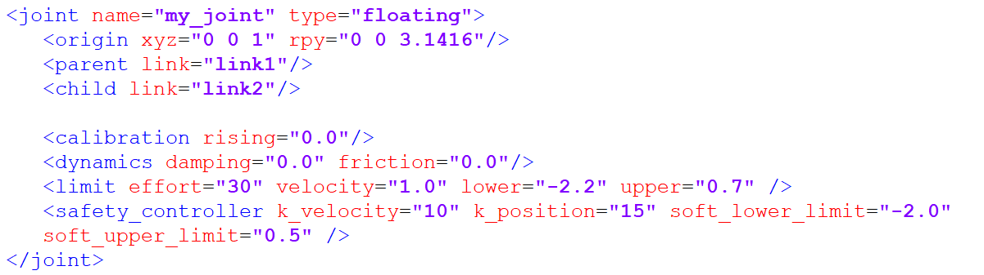
Links and Joints

Slide 32
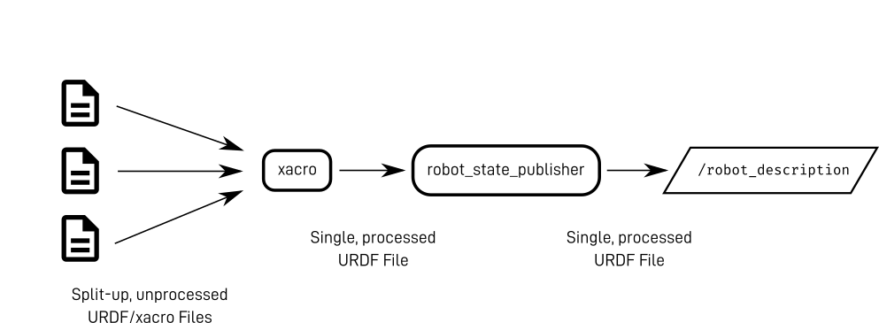
XML macro - xacro
URDF is generally long and repeatitive
Xacro lets us manipulate the URDF files easier by
  splitting up code into multiple files
  avoiding duplicate code
  Declaring properties
Notes:
https://www.youtube.com/watch?v=BcjHyhV0kIs&list=PLunhqkrRNRhYAffV8JDiFOatQXuU-NnxT&index=2

Slide 33
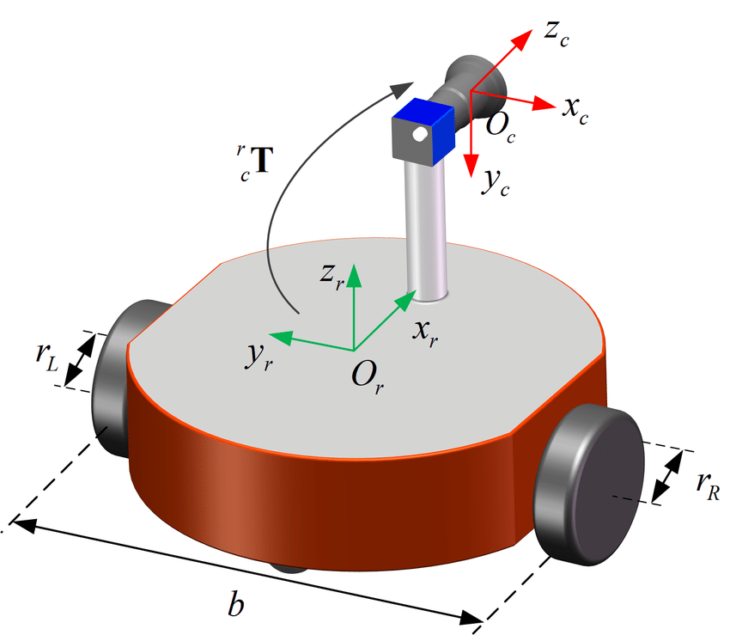
Exercise
Create URDF for a differential drive robot

Slide 34
Simulation the robot
in Gazebo

Slide 35
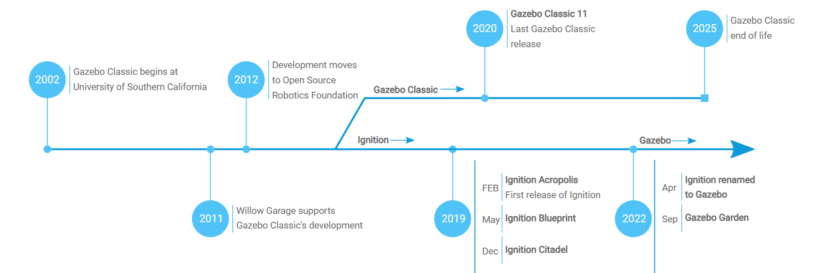
Gazebo
Gazebo is a leader in robot simulation, created in 2002
Official website: https://gazebosim.org/

Slide 36
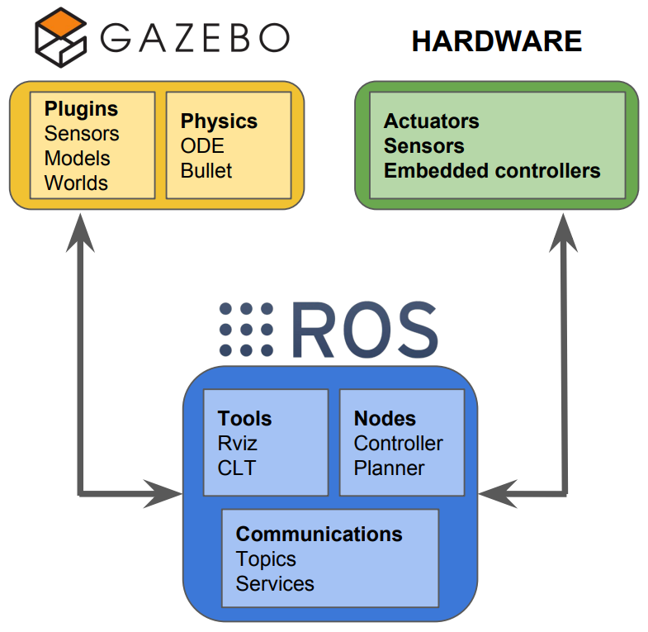
Gazebo
Gazebo is a 3D simulator with the ability to
  accurately and efficiently simulate robots, sensors, and objects in a 3-D dynamic environment
  Generates realistic sensor feedback and physical interactions between objects
Why simulation?
  Save time and your sanity
  Experimentation much less destructive
  Use hardware you don’t have
  Create really cool videos

Slide 37
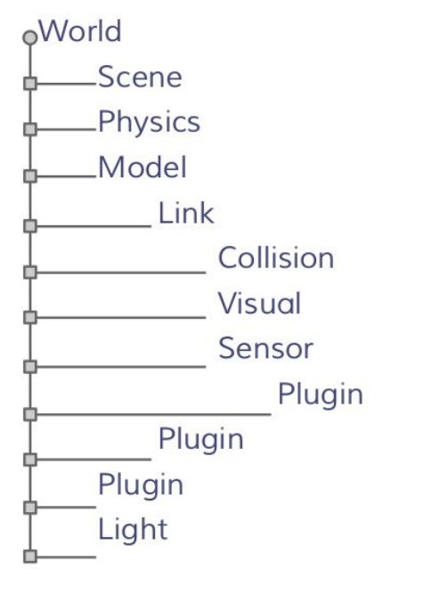
Elements in Gazebo
World
  A world is composed of a model hierarchy
  The Gazebo server reads the world file to generate and populate a world
  World file:
    Has “.world” extension
    Contains all the elements in a simulation, including scene, robots, lights, sensors, and static objects
  Build a world:
  https://classic.gazebosim.org/tutorials?tut=build_world

Slide 38
Elements in Gazebo
Model
  Model is a collection of links, joints,sensors, and plugins
  Model is defined using formatted using SDF (Simulation Description format) or URDF (Unified Robot Description Format)
  Each model contains a few key properties:
    Physical properties: visual, kinematics, dynamics, appearance
    Control and feedback interfaces (libgazebo)
  Create SDF from URDF
https://classic.gazebosim.org/tutorials?tut=ros_urdf

Slide 39
Elements in Gazebo
Plugin
  Gazebo plugins give your URDF models greater functionality
    Return sensor values
    Control motors
  Types of plugin:
    ModelPlugins
    SensorPlugins
    VisualPlugins
  More detail:
https://classic.gazebosim.org/tutorials?tut=ros_gzplugins

Slide 40
Elements in Gazebo
Sensor
  Collect, process, and output sensor data
  Types of sensor:
    Ray sensor: produces distance data
    Camera (2D and 3D): produces image and/or depth data
    Contact: produces collision data
    RFID: detects RFID tags
    IMU: produce Inertial Motion Unit data
  Example:
https://classic.gazebosim.org/tutorials?tut=ros_gzplugins

